Slide 1



SAP UI5 FIORI
Introduction To OOPS ABAP
www.zarantech.com
© Copyright 2021, ZaranTech LLC. All rights reserved.

Slide 2


Disclaimer
2
This presentation examples, images, and references are provided for informational purposes only.
Complying with all applicable copyrights laws is the responsibility of the user.
Without limiting the rights under copyright, no part of this document may be reproduced, stored or introduced into a retrieval system, or transmitted in any form or by any means.
Credits shall be given to the images taken from the open-source and cannot be used for promotional activities.
© Copyright 2021, ZaranTech LLC. All rights reserved.

Slide 3
Agenda
3
OOABAP Overview
Why OOABAP
Key Features of OOPS
Procedure vs object oriented approach
Basic concepts.
Advantages of OOABAP
© Copyright 2021, ZaranTech LLC. All rights reserved.

Slide 4

₂ What is OOABAP?
Object Oriented ABAP or OOABAP is the object-oriented extension of ABAP, which mainly focuses on the object rather than the code flow.
An object-oriented approach enables programmers to think like they are working with real-life entities.

Slide 5
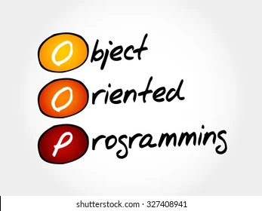
₂ Why OOABP?
Solutions are designed in terms of real-world objects
So it becomes easier for programmers and business analysts to exchange ideas and information about a design that uses a common domain language.
Just take a real-life scenario, a person having knowledge can do various works, same in oops, object have fields to store data and with which it can do various works.

Slide 6

₂ The key features of object orientation
Effective programming structure.
Real-world entities can be modeled very well.
Stress on data security and access.
Minimizes code redundancy.
Data abstraction and encapsulation.

Slide 7
Procedure v/s Object oriented approach
Procedure | Object oriented
Emphasis is on tasks. | Emphasis is on things that does those tasks.
Most of the functions share global data. | Data can be hidden and can’t be accessed by external sources.
Programs can be divided into smaller programs known as functions. | Programs are organized into classes and objects and the functionalities are embedded into methods of a class.
This is more time consuming to modify and extend the existing functionality. | New data and functions can be added effortlessly as and when required.

Slide 8
Basic and Most Important Elements of OOPS
Class
object
OOPS
Concepts
Abstraction
Encapsulation
Polymorphism
Inheritance

Slide 9
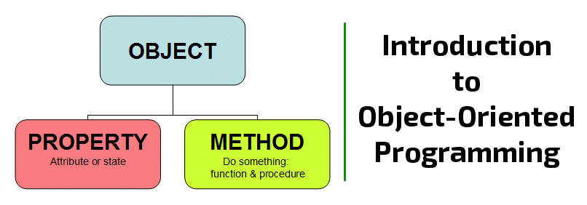
Objects
It’s a working entity of a class.
Each object is unique at its own, meaning with unique identity and attributes.
Attributes defines the state of an object whereas behavior of an object refers to the changes that occur in its attributes over a period of time.
An object can be associated with the class by declaring it with the same data type as of the class within which an object has been created.

Slide 10
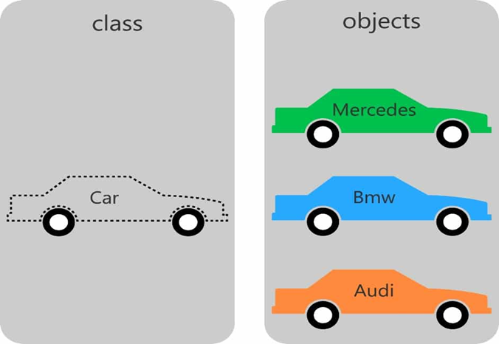
Class
A class is like a blueprint of an object or a template that binds similar kind of data. It defines the characteristics of an object. Following are the components of class:

Slide 11
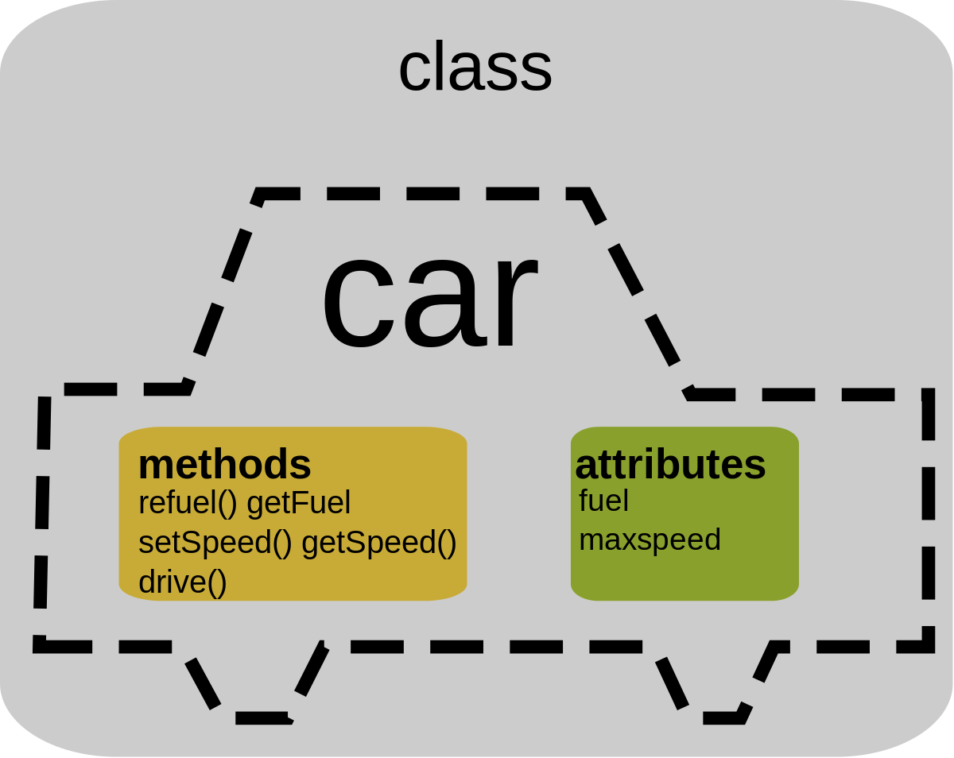
The Concepts Of Class
Attribute – variables or constant declared within the class and can be access by all the methods of that class.
Method – Determines the behavior of an object, it provide some functionality. A method can access all the attributes of their class.
Methods are defined in the definition part of a class and implement it in the implementation part using the following processing block:
METHOD <meth>.
...
ENDMETHOD.
Methods are called using the CALL METHOD statement.

Slide 12
The Concepts Of Class
Events – A mechanism through which one method can raise method of another class.
Interface – Independent structure which are used in a class to extend functionality of a class.
Alias – A concept of providing alternate method name for interface method in an implemented class.

Slide 13
Component Types Of Class
Instance Component (instance attributes, instance methods & instance events) – These components can only be addressed by the instance(object) of that class only.
Instance components exist separately in each instance (object) of the class and are referred using instance component selector using ‘->’.

Slide 14

Component Types Of Class
Static Component (static attributes, static method & static events) – These components can be used independently of a class instance.
Static components only exist once per class and are valid for all instances of the class. They are declared with the CLASS- keywords
Static components can be used without even creating an instance of the class and are referred to using static component selector’=>’

Slide 15
Method Parameters
Instance Component transfers a value from the caller to the called method by passing an actual parameter
EXPORTING is just opposite to what IMPORTING does. IT passes value from the method to Caller.
CHANGING is transferring the value from caller to method by a variable which is processed or changed and the changed value is passed back to the Caller. Thus it combines both IMPORTING and EXPORTING function.

Slide 16

Abstraction
Main goal is to handle complexity by hiding unnecessary details from the user.
This enables the user to implement more complex logic on top of the provided abstraction without understanding or even thinking about all the hidden complexity.
In general, the abstraction is the act of removing characteristics from something in order to reduce it to a set of essential functions or characteristics.

Slide 17
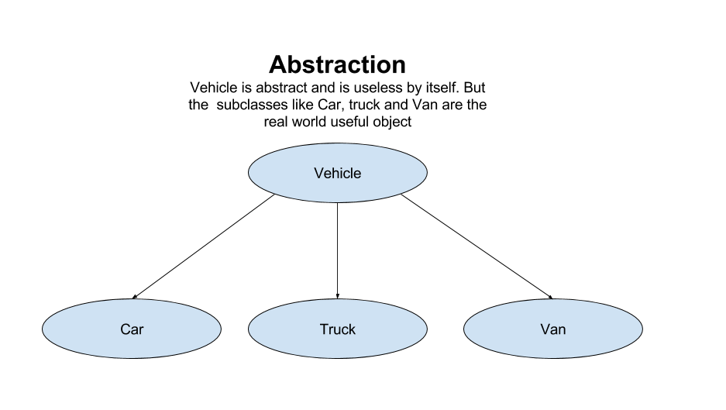
Abstraction

Slide 18

Encapsulation:
Encapsulation is the process of combining data and code into a single unit (object / class).
In OOP, every object is associated with its data and code. In programming, data is defined as variables and code is defined as methods.
The java programming language uses the class concept to implement encapsulation.
Encapsulation may also refer to a mechanism of restricting the direct access to some components of an object, such that users cannot access state values for all of the variables of a particular object.

Slide 19
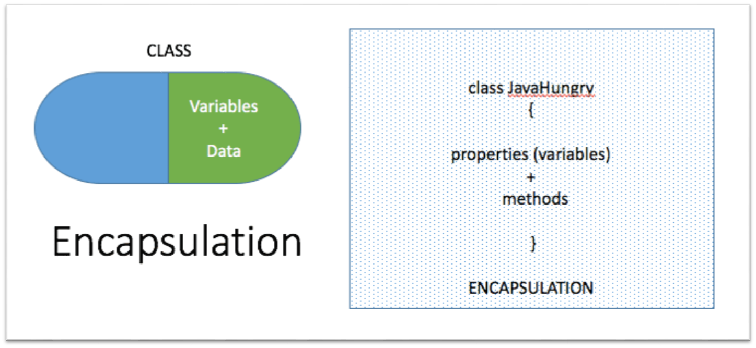
Encapsulation

Slide 20
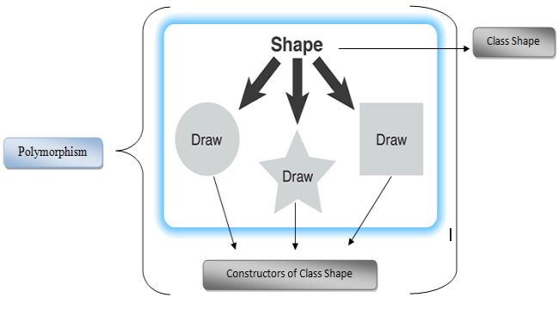
Polymorphism
It means using one thing for different operations
It occurs usually in inheritance – for e.g. redefining methods which we saw under the concept of inheritance
Polymorphism means redefining methods to either overload them or override them
Overloading methods means when we use the same method name but use different parameters
Overriding methods means when we use the same method name and parameters, but the two methods are related via inheritance relationship

Slide 21
Polymorphism
Polymorphism
Static /Compile Time
Dynamic/Run Time
Function Overloading
Operator overloading
Method overloading

Slide 22
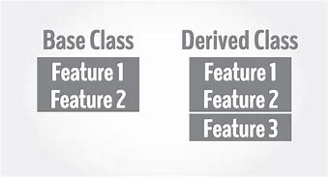
Inheritance
It allows a sub class or a child class to inherit the properties from a parent class.
In OOABAP, only single and multilevel inheritance is allowed.
Single inheritance means only one parent class and its child class.
Multilevel Inheritance means a parent class can have a child class, it grandchild class and so on with the hierarchy.
The main advantage of inheritance is reusability of code functionality & fast implementation time.

Slide 23
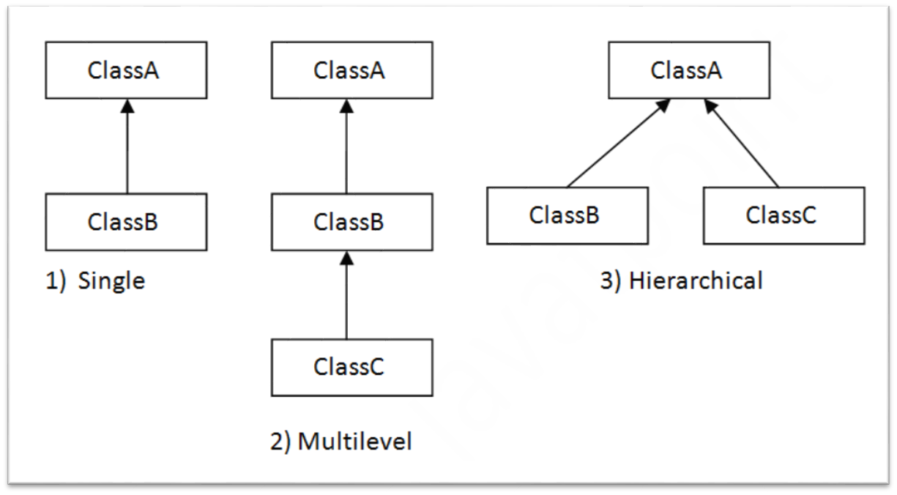
Inheritance

Slide 24
Advantages of OOABAP
In OOABAP, programs are divided into objects leading to better and powerful data management.
Provide properties like data hiding(encapsulation) & code reusability(inheritance) with more data security.
Better performance with less consumption of time.
Helps in future orientation.
Simple and it much easier to maintain as compare to procedural ABAP programming.

Slide 25

Advantages of OOABAP
Relatively flexible & adaptable to changing business needs.
Object Oriented programming languages include features such as “Class”, “Instance”, “Inheritance” and “Polymorphism” that increase the power and flexibility of an object.

Slide 26

Thank you
Subscribe to our Channel for more Informative Videos. https://www.youtube.com/user/ZaranTech

